Slide 1


Dynamic Calibration of Pressure Transducers in a Shock Tube: Boundary Layer Stability & Transition Laboratory
Dashiel Pudwill
April 18, 2020

Slide 2
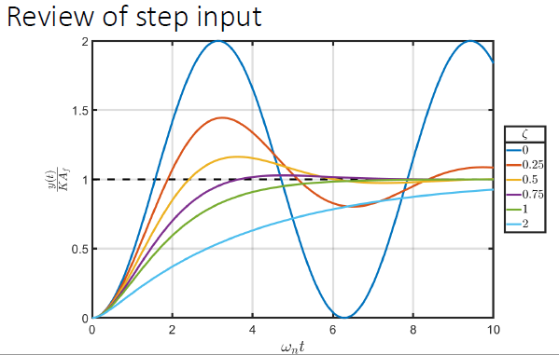
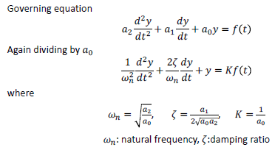
Background/Motivation
Pressure Transducers:
  Second-order Systems
    Governing equation of the form shown below
Dynamic Cell:
  Determine resonance, damping, and frequency response of pressure transducers
  Ability to calculate/account for how the sensor signal will change in response to step function
  Allows for better data processing through output filtering
Source: UofA AME 300
Second-order systems’ response to a step-input=1 with different values of damping ratios

Slide 3
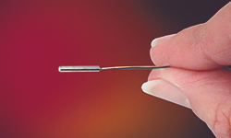
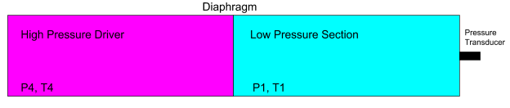
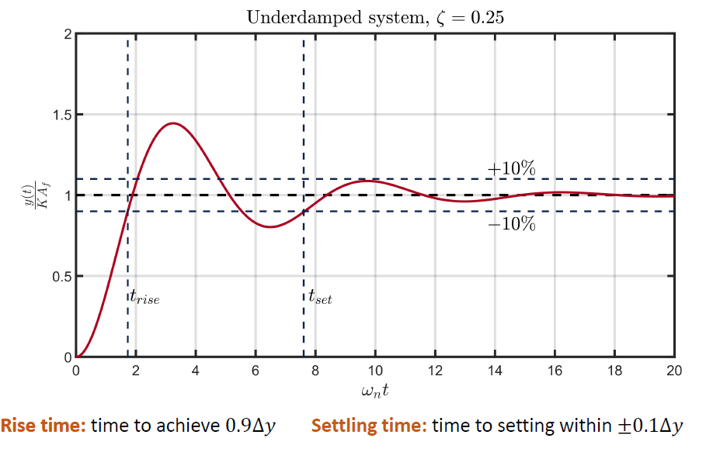
Purpose of Dynamic Cell
Create a shock to impact a Kulite (brand of pressure transducer) mounted at the end of a shock tube
  By mounting the transducer on the end-cap of the shock tube, a clean step function, pressure vs time, is what the Kulite is attempting to measure
  Output signal of Kulite will be able to determine the rise time, settling time, natural frequency, and overall frequency response of the transducer
  The diaphragm of the Kulite is the part of the device we wish to characterize
  Model to be used: XCE-062
Shock Tube replicates shock conditions (scaled) on the Kulites experienced in the full-size tunnels
Information about frequency response can be applied to output filtering and the signal conditioners to have cleaner data collection
Source: Kulite
Source: UofA AME 300

Slide 4
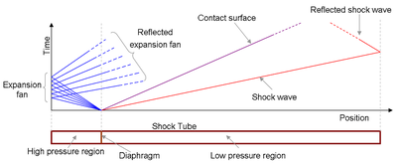
Design Considerations for the Dynamic Cell
Ideal design will allow 100 ms time delay between shock impact on transducer and the interference of expansion waves (being reflected back into transducer from wall).
  Utilize X-t diagrams: illustrate at which point interference from expansion waves occurs.
Shock wave needs to have sufficient time to normalize (become perpendicular to tube wall).
  Shock needs to be able to collapse upon itself to have linearity.
  Shock tube has an inner diameter of 3.068 inches.
  Shock must move 20-times the pipe diameter (61.36 inches or 5.11 feet) to fully normalize prior to impacting Kulite.
Diaphragm should burst beginning at center to have uniform shock formation/consistent starting of tube
  Use thin mylar sheets for diaphragm
Structural considerations
  Use of 304/316 stainless steel because of their resistance to corrosion
  Schedule 40 pipe used to ensure the pipe would be safe at designed pressures with a large factor of safety
  Nominal pipe size of 3 inches was most cost efficient while attempting to maximize volume for air flow
Source: Wikipedia

Slide 5


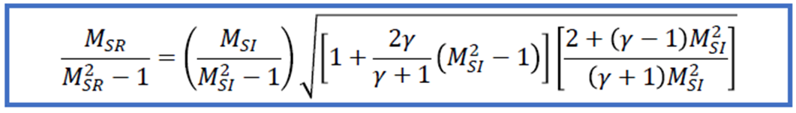
Approach
Generate a normal shock to induce pressure increase across transducer
Pressure ratio designed to accurately match conditions experienced in wind tunnel test section (as closely as possible)
Can determine pressure and temperature ratios from
incident and reflected shock waves

Slide 6
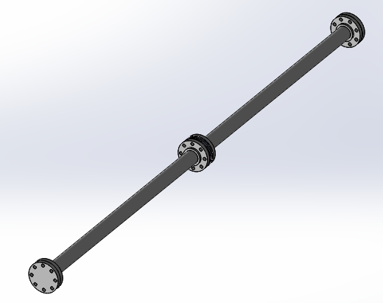
Dynamic Cell Design
Kulite mounted in back-wall of the shock-tube (to have as close to perfect of a step function being measured)
Total Shock Tube Length: 12 feet (2x 6 feet pipes)
Inner Diameter of Shock Tube: 3.068 inches
Bolt on flanges to form the ends of the shock tube
Weld on flanges on the inner ends of the two pipes
Diaphragm portion formed by four individual steel plates
    Two permanent plates to match inner diameter of the pipe
    Two removable plates that will hold the mylar in between them, modifiable
    Dowel pins ensuring alignment between each set of plates
Material: Stainless Steel

Slide 7
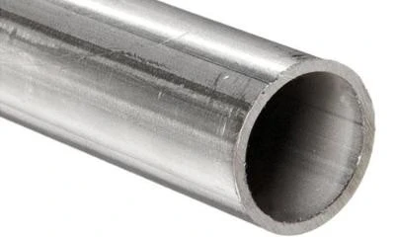
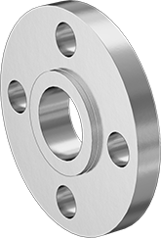
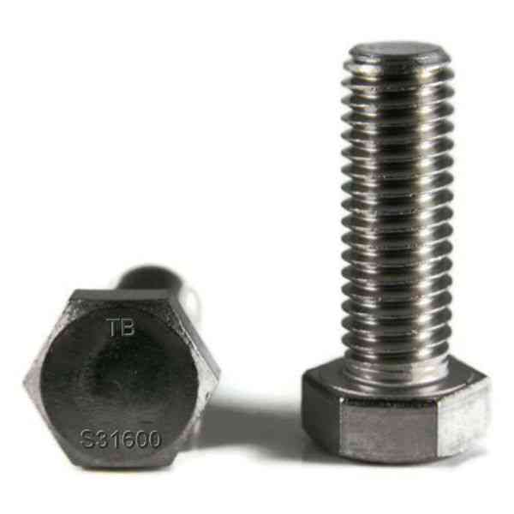
Parts Received/Raw Materials
(2) Six-foot stainless steel pipes
(4) Unthreaded stainless steel flanges
(2) Stainless steel end caps
(2) ¼ inch thick stainless steel plate
(2) ½ inch thick stainless steel plate
Stainless steel bolts
Stainless steel dowel pins
Source: Des Moines Steel
Source: McMaster Carr
Source: TorqBolt

Slide 8
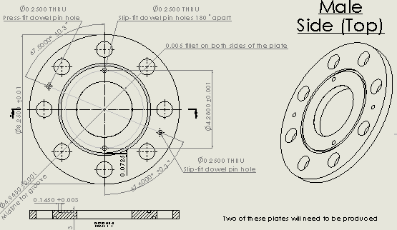
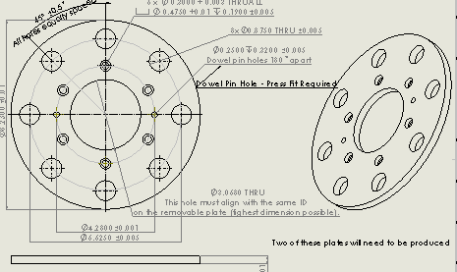
Drawings of Parts to be Machined

Slide 9
Difficulties to Overcome
Flanges must be welded to the pipe; very difficult to implement while keeping the parts concentric
  Thus, the requirement for the two additional permanent plates to ensure there is no step from the driver section to the vacuum section
After welding, additional machining is very difficult with such a large assembly (in-house machine shop does not have lathe large enough to accomplish this)
  The flange may be welded crooked onto the pipe
  The end of the pipe may have come out of round near the welding region
Characterizing of mylar sheets
  Due to material properties, a given thickness of mylar may burst at a variety of different pressures
    Multitude of tests must be performed to average the data
    The thickness of mylar determines the pressure difference before it burst and thus the Mach number of the shock tube

Slide 10
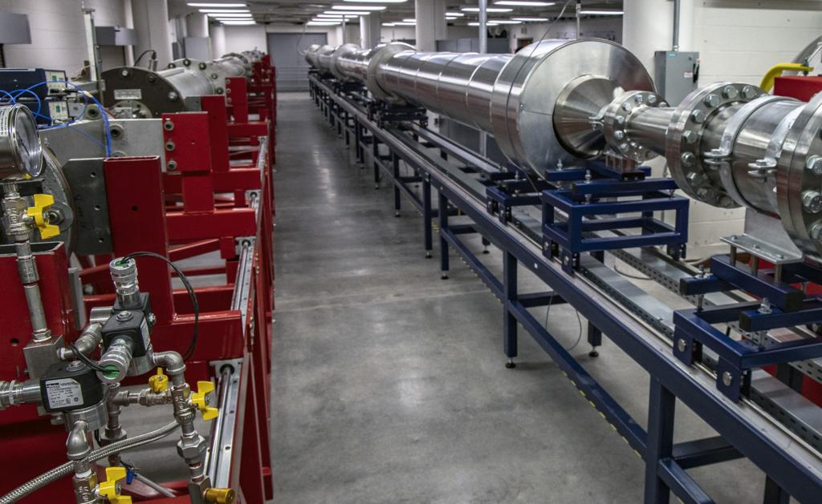
Next Steps
Welding of pipe to flanges
Machining of permanent and removable plates
Design of Kulite mount on end cap of shock tube
Design of vacuum and pressure lines into opposing ends of the dynamic cell
Construction of a saddle to hold the shock tube
Characterization of mylar diaphragms
Testing -> recording of frequency response of Kulite
Implementation of recorded data through output filtering in real wind-tunnels
Source: UofA AME Department

Slide 11
Thank You

